Slide 1



Understanding Structural Vulnerability in Graph Convolutional Networks
Jintang Li (李金膛)
Sun Yat-sen University
lijt55@mail2.sysu.edu.cn

Slide 2
Outline
Background
Robustness Analysis
Experiments & Results
Conclusion & Future Work

Slide 3
Outline
Background
Robustness Analysis
Experiments & Results
Conclusion & Future Work

Slide 4
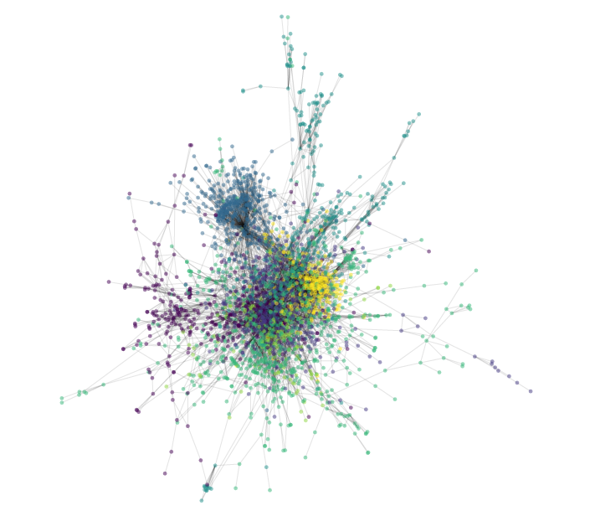
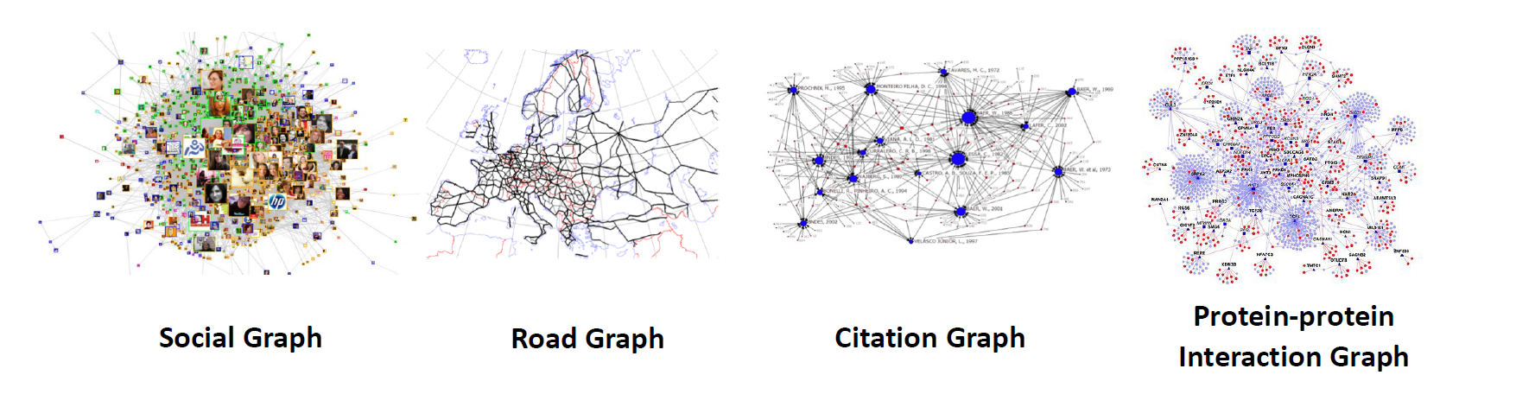
Deep Learning on Graphs
Graphs are ubiquitous
Social networks
Web graphs
Knowledge graphs
…

Slide 5

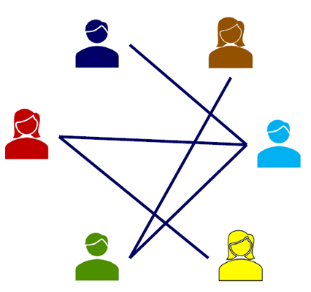
Deep Learning on Graphs
Social networks
Who-friends-whom

Slide 6
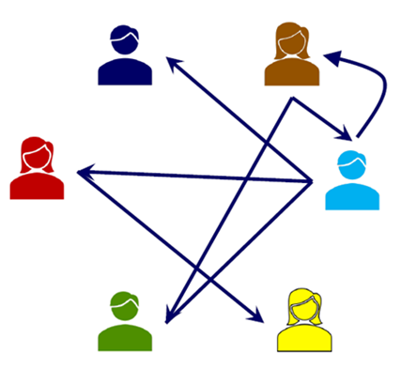

Deep Learning on Graphs
Social networks
Who-friends-whom
Who-follows-whom
Who-retweets-whom

Slide 7
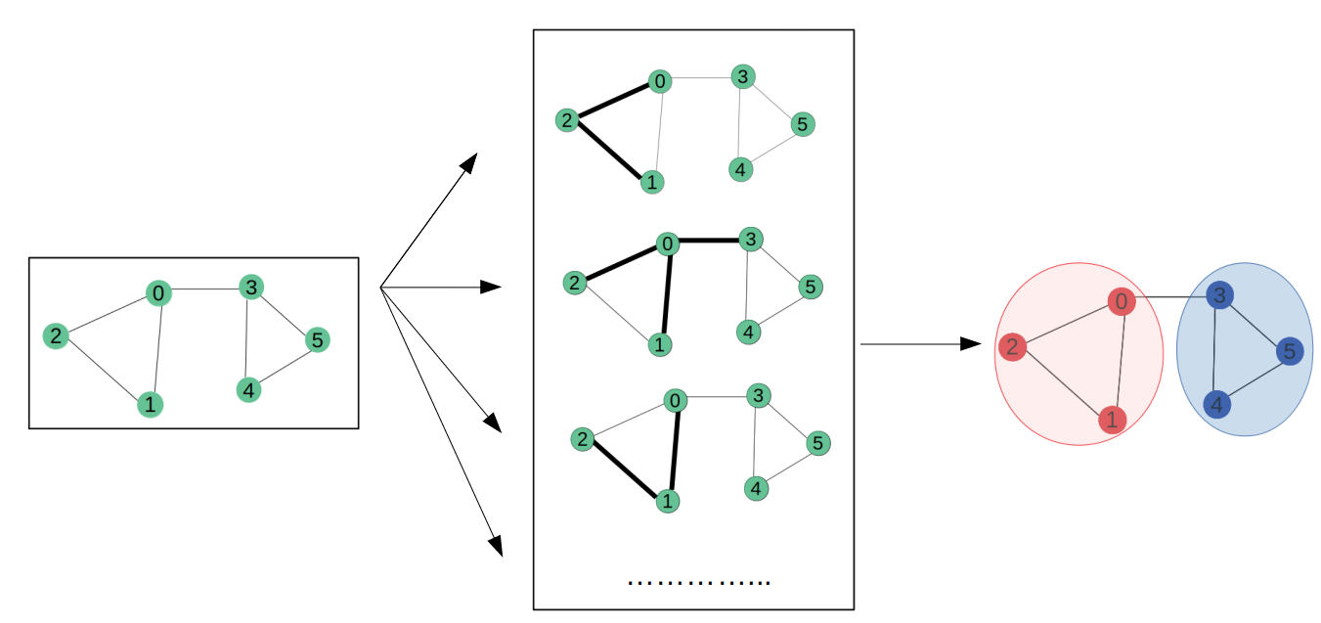
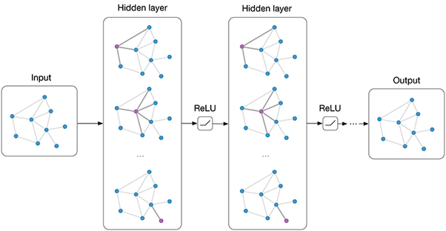
Graph Convolutional Networks (GCNs)
Graph Convolutional Networks (GCNs) are prevalent
Graph classification
Link prediction
Graph clustering
Node classification

Slide 8
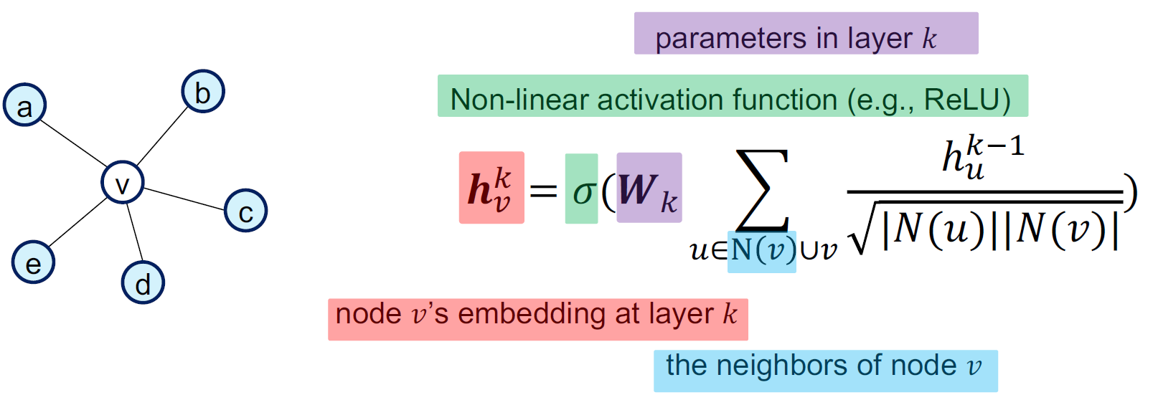
Graph Convolutional Networks (GCNs)
Neighborhood Aggregation:
Aggregate neighbor information and pass into a neural network
It can be viewed as a center-surround filter in CNN---graph convolutions!

Slide 9
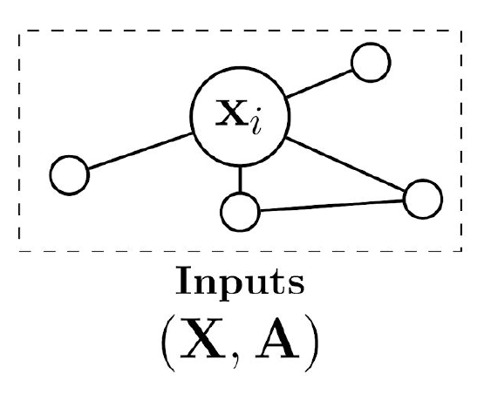
Graph Convolutional Networks (GCNs)
GCNs and Message passing

Slide 10
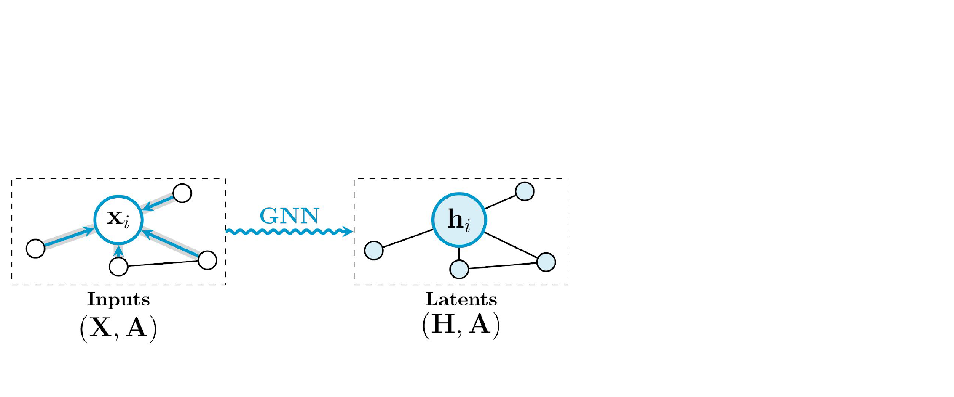
Graph Convolutional Networks (GCNs)
GCNs and Message passing

Slide 11
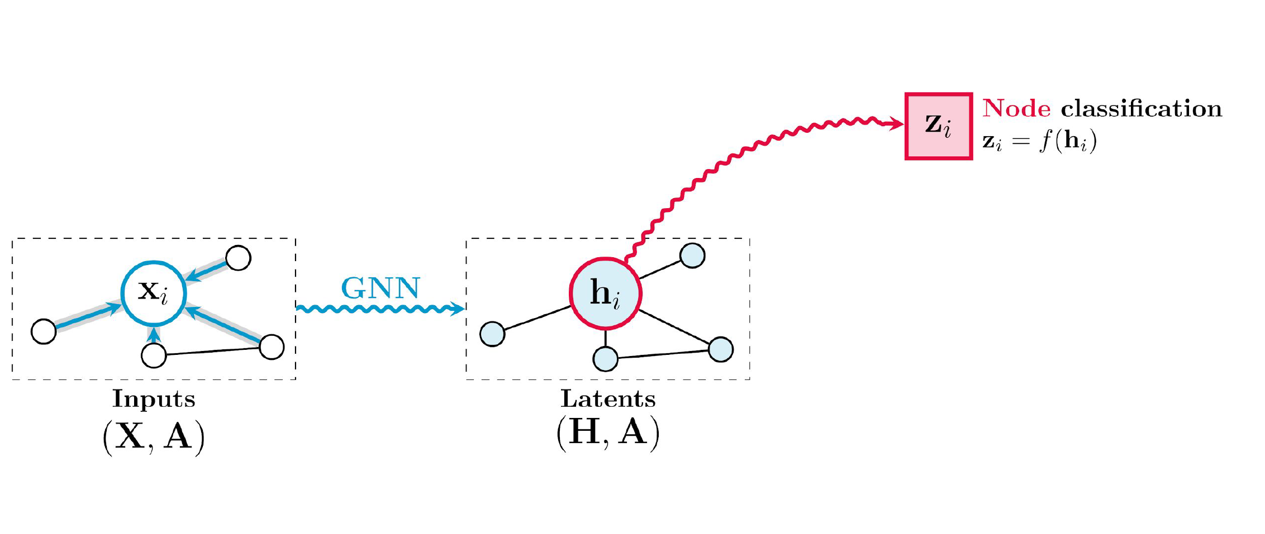
Graph Convolutional Networks (GCNs)
GCNs and Message passing

Slide 12
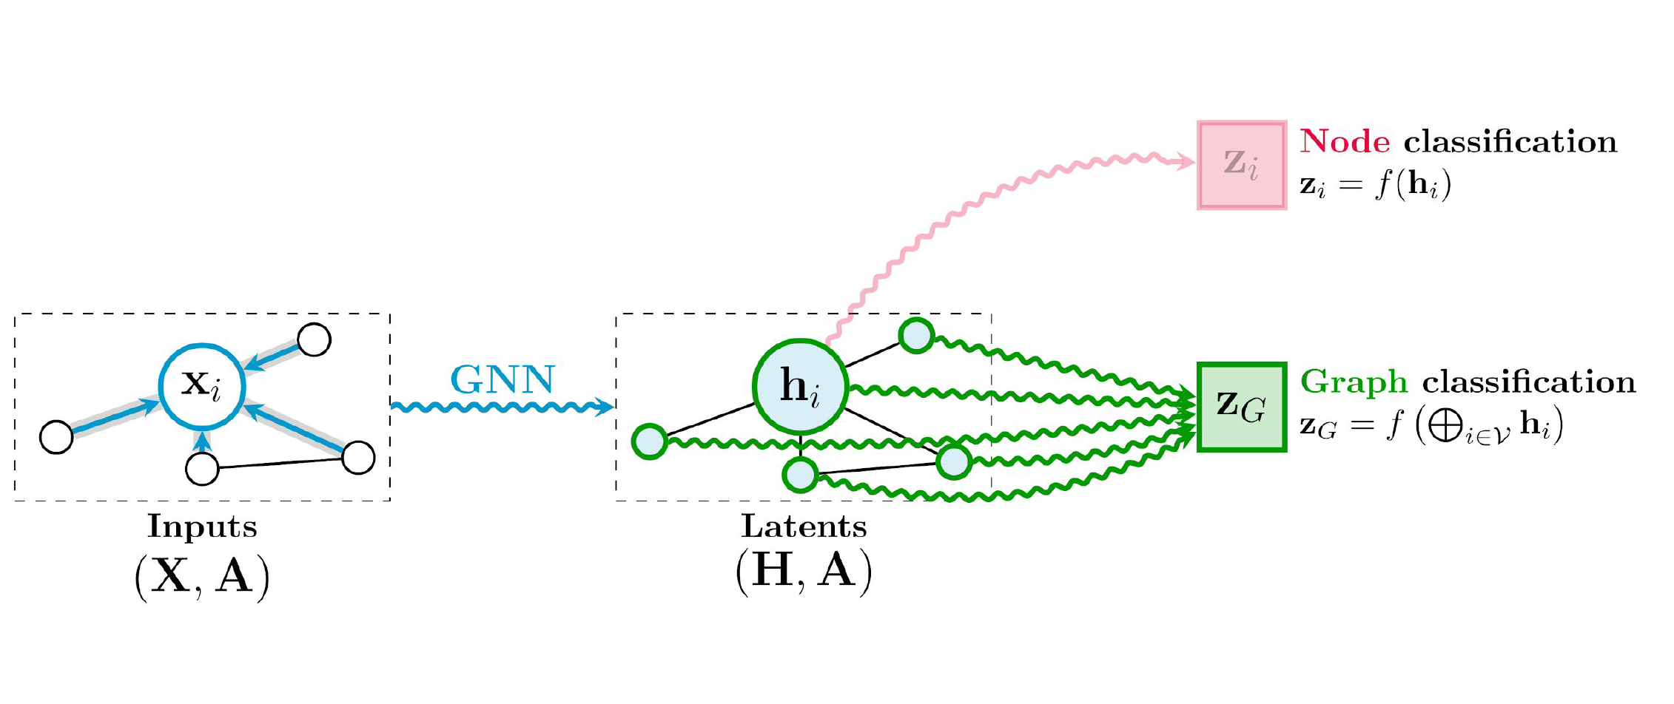
Graph Convolutional Networks (GCNs)
GCNs and Message passing

Slide 13
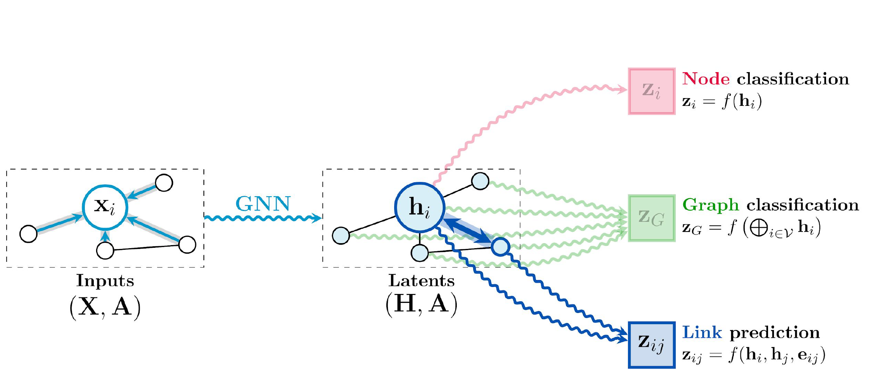
Graph Convolutional Networks (GCNs)
GCNs and Message passing

Slide 14
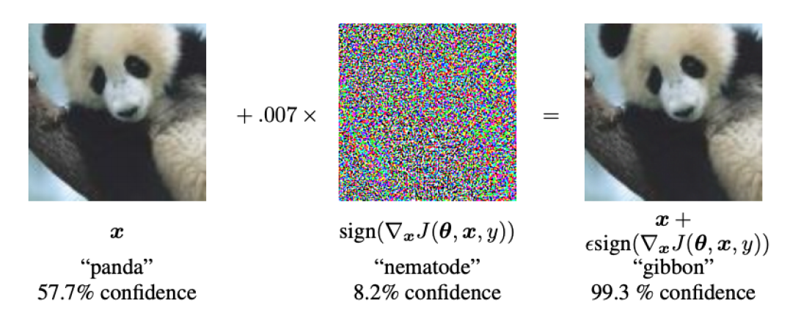
Adversarial Attack on Images
AI could be easily fooled
Are deep learning models for graphs robust
with respect to adversarial attacks?
Goodfellow, I. J., Shlens, J., and Szegedy, C. Explaining and harnessing adversarial examples. 2015 ICLR

Slide 15
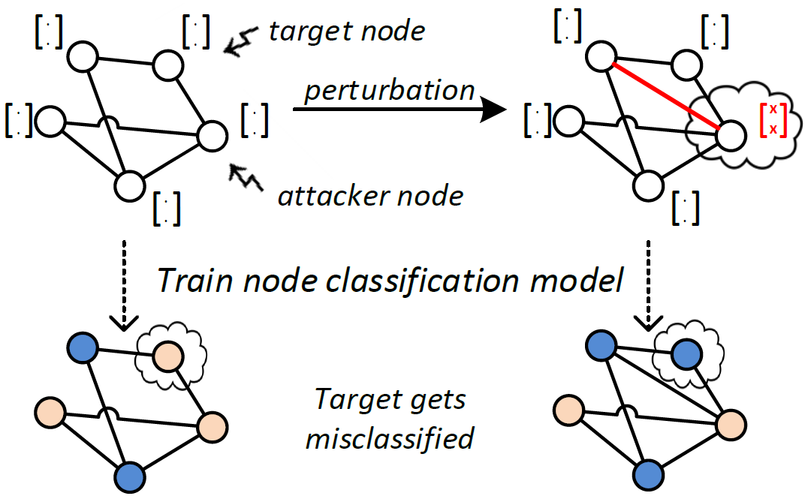
Adversarial Attack on Graphs
Adversaries are very common in application scenarios, e.g. search engines, or recommender systems
These adversaries will exploit any vulnerabilities exposed
Adversarial attacks are a real threat. When dealing with graphs, we need to rethink possible defense strategies

Slide 16
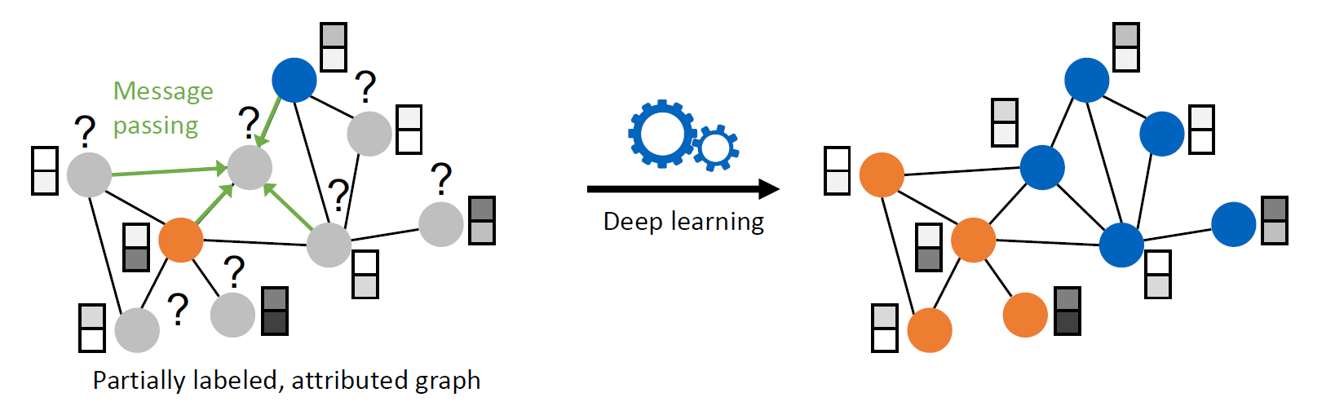
Vulnerability of GCNs
Message passing (a.k.a. Neighborhood Aggregation) aggregates local information. This could mean higher robustness – or lower robustness due to cascading failures!

Slide 17
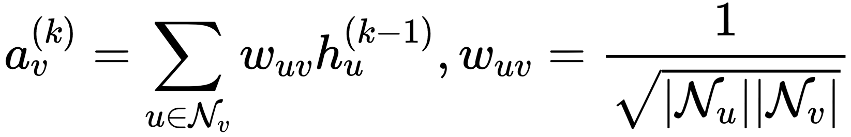
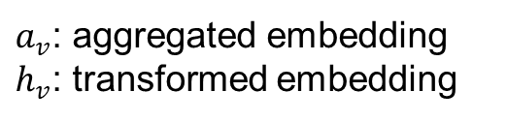
Adversarial Attack on Graphs
Graph Convolutional Networks, i.e., GCNs, are non-robust!
Benign Node
Vicious Node
Attack
Node Features
Message Passing
High robustness
Low robustness
$a_{v}$: aggregated embedding
$h_{v}$: transformed embedding

Slide 18
Adversarial Defense on Graphs
Data-Level Defense
Preprocess graph data before training/testing vs. poisoning/evasion attack
Model-agnostic and flexible
Limited performance against stronger attacks
Model-Level Defense
Improved aggregation scheme or regularization techniques
Task-dependent and inflexible
Much robust against stronger attacks

Slide 19
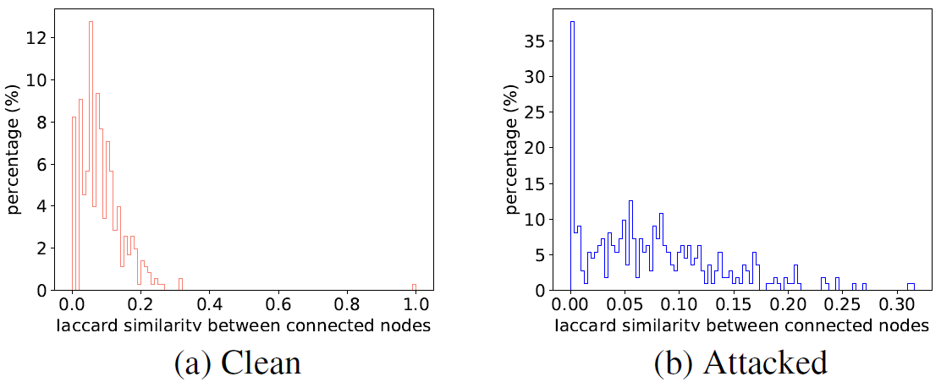
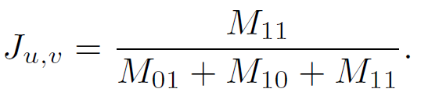
Adversarial Defense on Graphs
Jaccard-based Defense
The attack approaches tend to favor adding edges over removing edges
Attackers tend to connect very dissimilar nodes, results in lower Jaccard similarity
Removing the edges that connect nodes with low Jaccard similarity score is an efficient way to defense
[Wu et al., 2019]
i
j

Slide 20
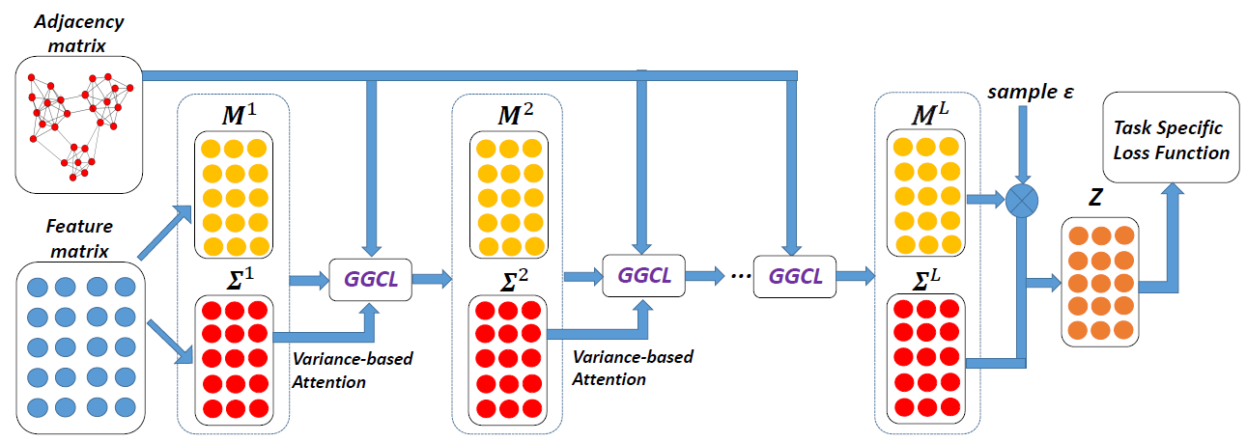
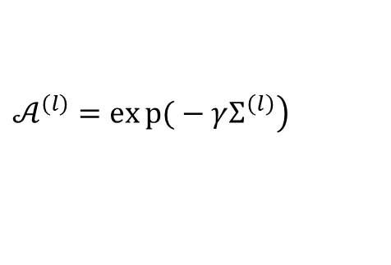
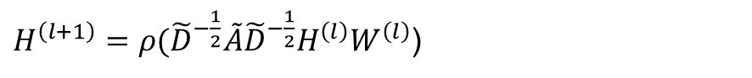
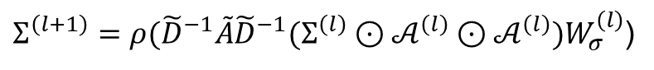
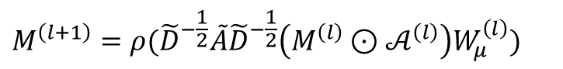
Adversarial Defense on Graphs
Robust Graph Convolution Network
GCN
$H^{\left(l+1\right)}=ρ({\tilde{D}}^{−\frac{1}{2}}\tilde{A}{\tilde{D}}^{−\frac{1}{2}}H^{\left(l\right)}W^{\left(l\right)}$)
Well performance over target task
High robustness against attack
Gaussian Distribution can absorb attack effects
Variance-based attention mechanism to prevent the propagation of attacks
RGCN
$$\left.𝒜^{\left(l\right)}=exp{(}−γΣ^{\left(l\right)}\right)$$
$$M^{\left(l+1\right)}=ρ({\tilde{D}}^{−\frac{1}{2}}\tilde{A}{\tilde{D}}^{−\frac{1}{2}}\left(M^{\left(l\right)}⊙𝒜^{\left(l\right)}\right)W_{μ}^{\left(l\right)})$$
$Σ^{\left(l+1\right)}=ρ({\tilde{D}}^{−1}\tilde{A}{\tilde{D}}^{−1}(Σ^{\left(l\right)}⊙𝒜^{\left(l\right)}⊙𝒜^{\left(l\right)})W_{σ}^{\left(l\right)}$)
[Zhu et al., 2019]

Slide 21
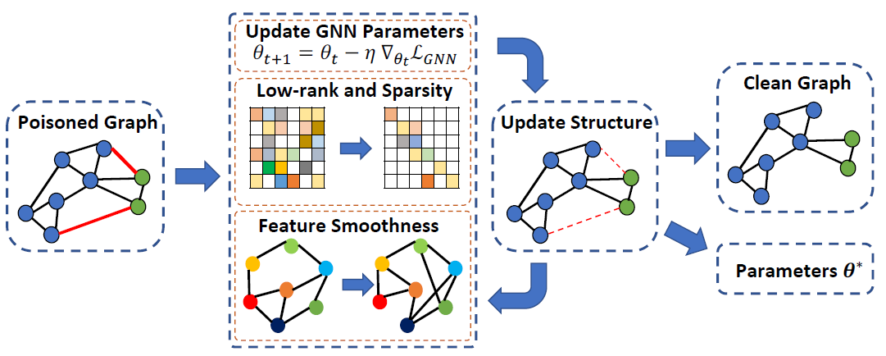
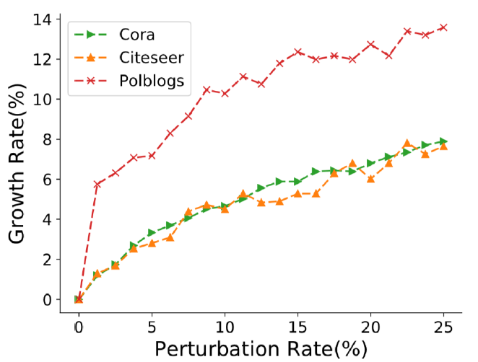
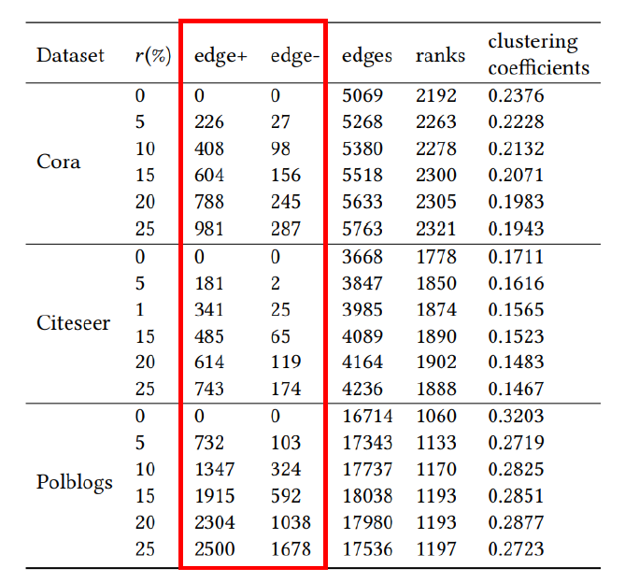
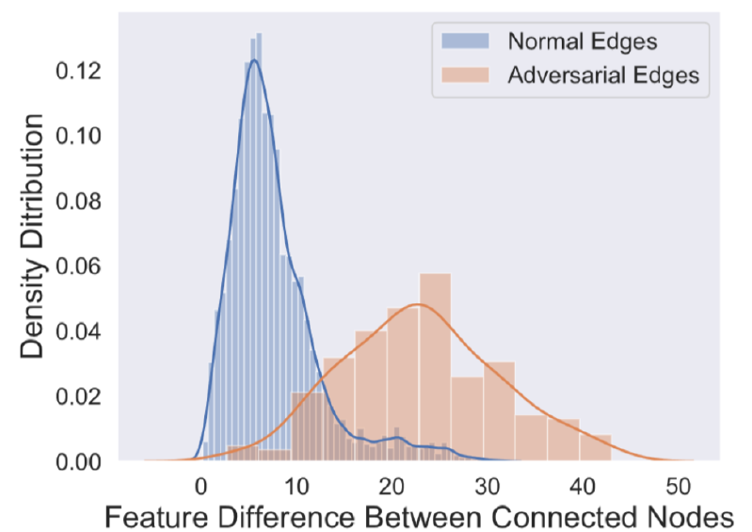
Adversarial Defense on Graphs
Pro-GNN
[Jin et al., 2021]
Rank
Graph properties
Low-rank
Sparsity
Feature smoothness
Sparsity
Feature
smoothness

Slide 22
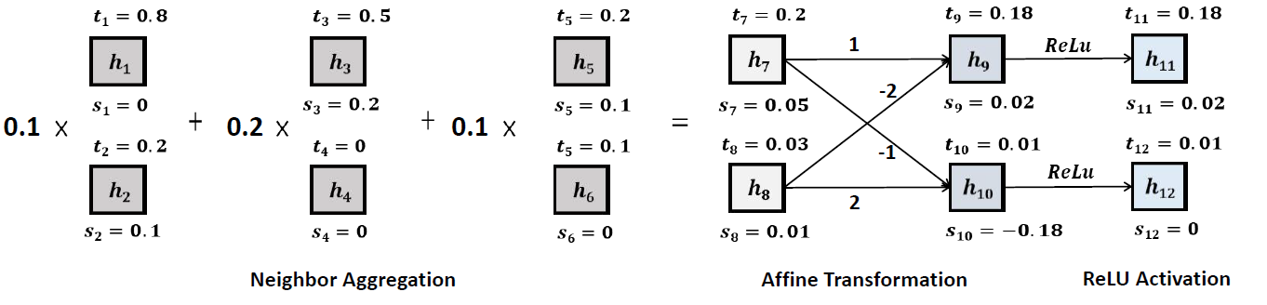
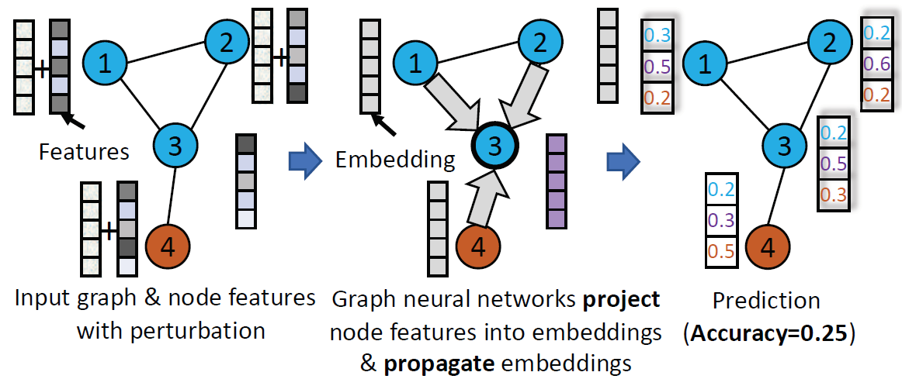
Adversarial Defense on Graphs
[Jin et al., 2021]
Why graph convolutional networks are vulnerable to adversarial structural attacks?
[Wu et al., 2019]
[Liu et al., 2020]
[Zhu et al., 2019]
[Feng et al., 2019]

Slide 23
Outline
Background
Robustness Analysis
Experiments & Results
Conclusion & Future Work

Slide 24


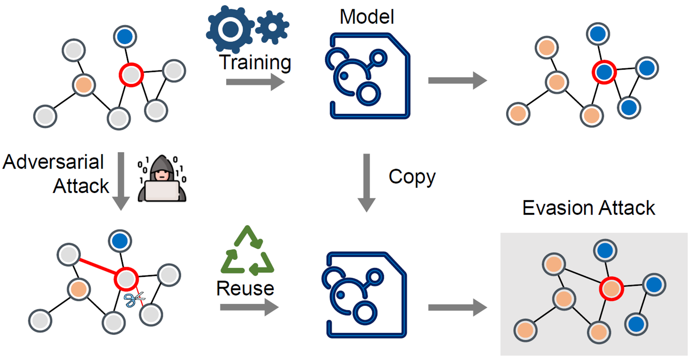
Attack Scenario
Targeted attack
Adversarial attacks on graphs can modify the graph structure
Even more critical: a node can be attacked without direct access due to network effects
Direct attack: perturbations on the target
Indirect attack: perturbations on other nodes
(a) Direct attack
Targeted node
Injected edge
Removed edge
(b) Indirect attack
Evasion attack
Transductive learning: data consists of labeled and unlabeled samples; all data used for training
Evasion attack: modify data to fool a static classifier
Evasion attack is prevalent in real world, e.g., a well-trained model in practical use

Slide 25
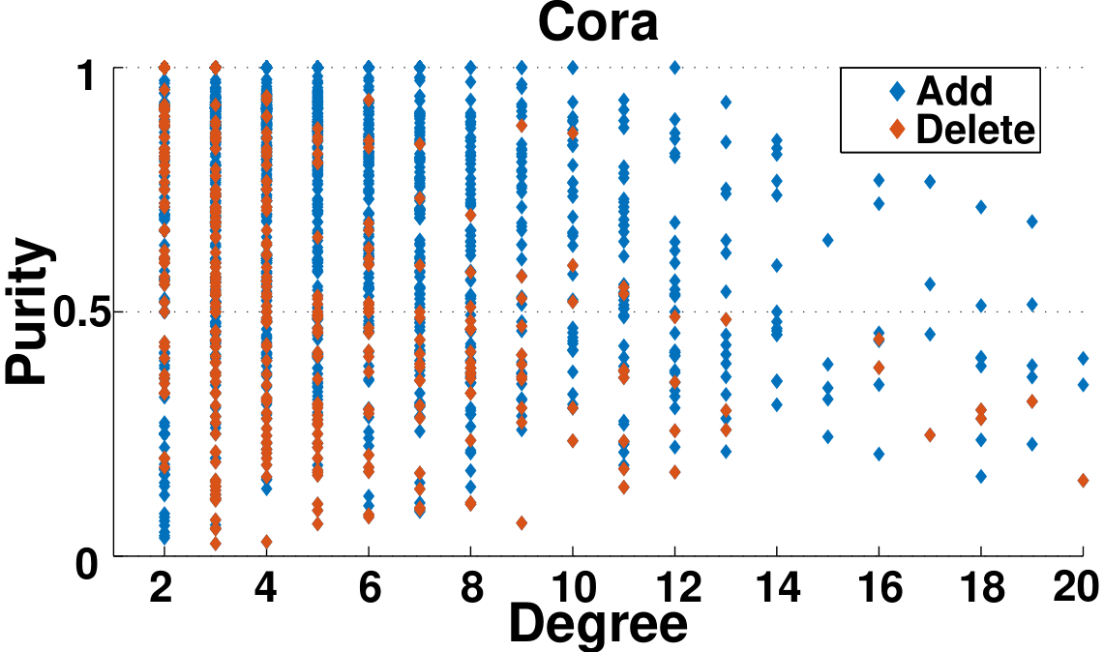
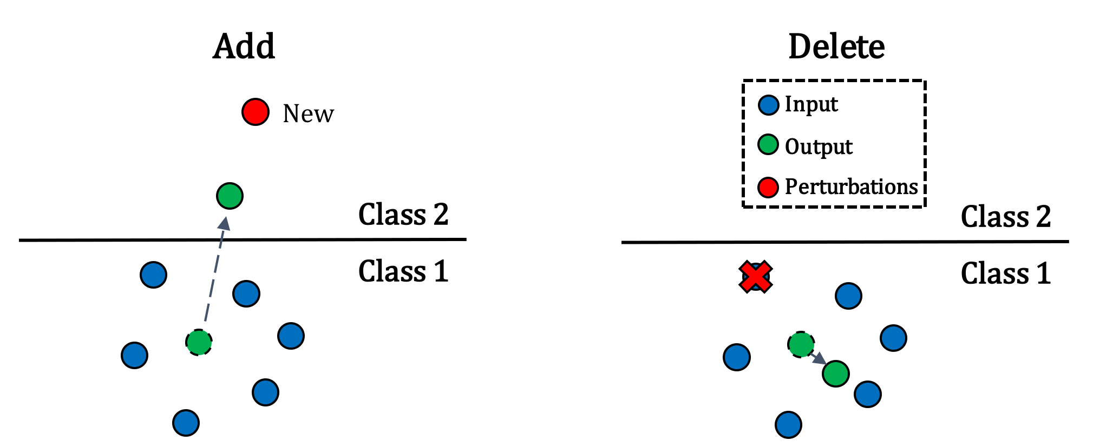
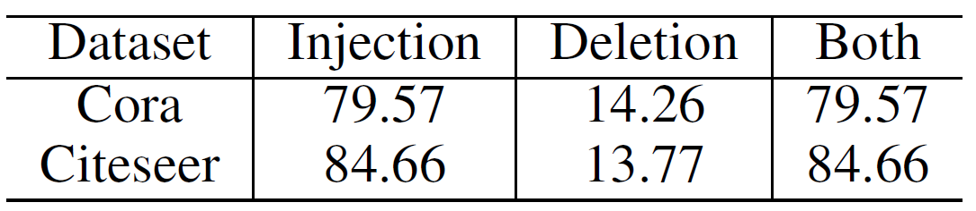
Empirical Analysis
Table: The percentage (%) of successfully attacked nodes
Most nodes can be successfully attacked by modifying only one edge
Injecting an edge can attack more nodes than deleting one
Attackers tend to add edges rather than remove them and reduce the purity of nodes

Slide 26
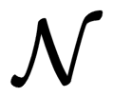
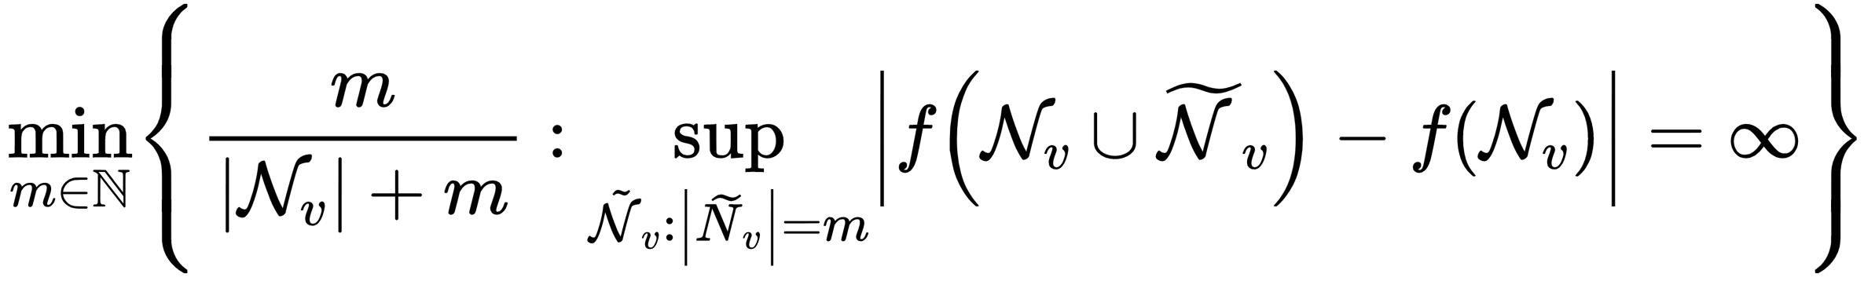
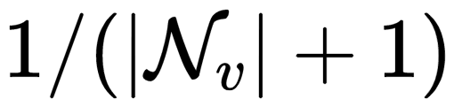
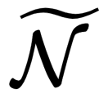
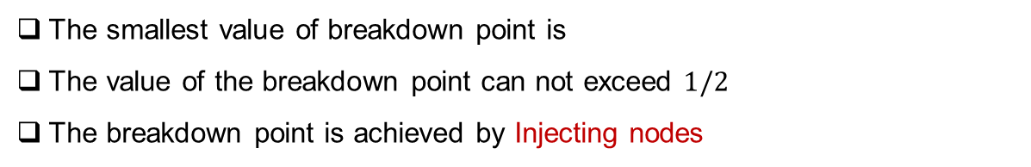
Robustness Analysis
Definition: Breakdown point $ϵ(f, )$ is defined as the smallest contamination fraction under which the aggregation function $f$ breaks down:
input nodes set
The smallest value of breakdown point is
The value of the breakdown point can not exceed $1/2$
The breakdown point is achieved by Injecting nodes
perturbation set

Slide 27
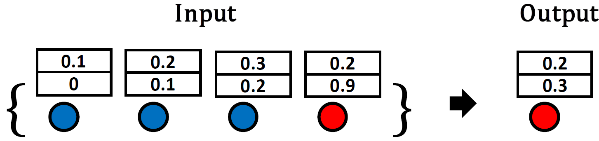
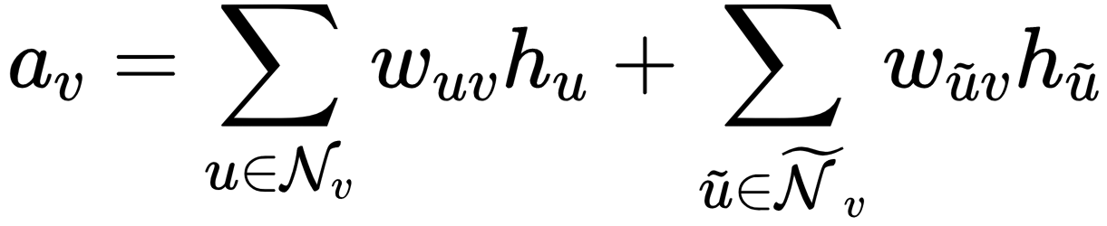
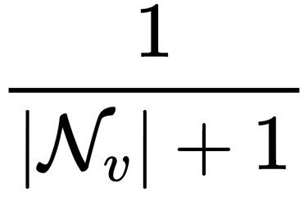
Our Argument
The non-robust aggregation function leads to structural vulnerability of GCNs
Benign
Vicious
breakdown point =
The output of GCNs can be easily changed by injecting a node with extreme value as feature

Slide 28
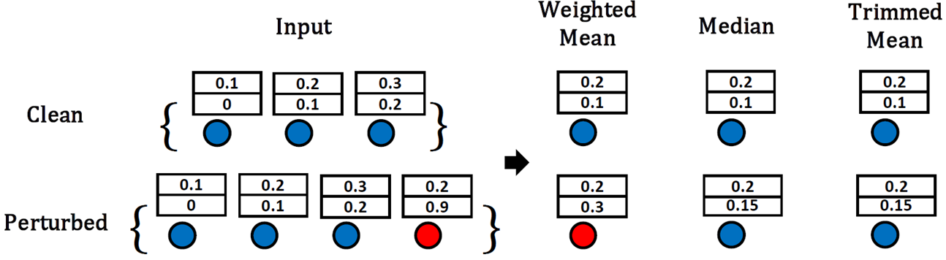
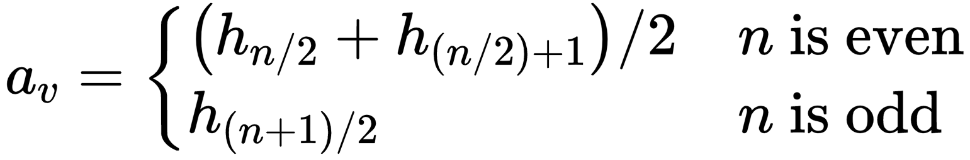
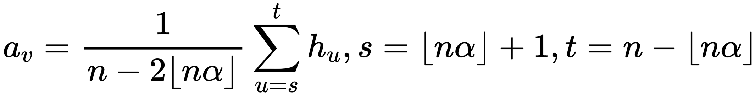
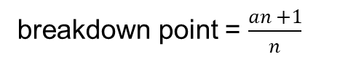
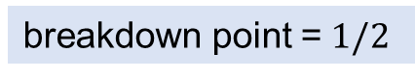
Our Argument
Robust aggregation functions
Median
breakdown point =$1/2$
Maximum
Trimmed mean
breakdown point = $\frac{an +1}{n}$

Slide 29
Outline
Background
Robustness Analysis
Experiments & Results
Conclusion & Future Work

Slide 30
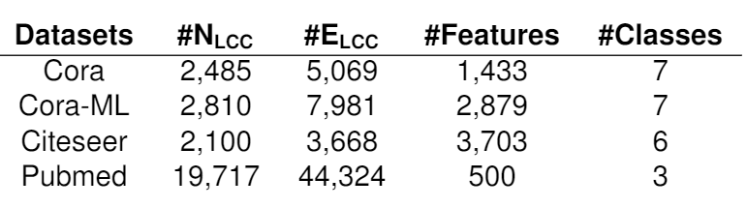
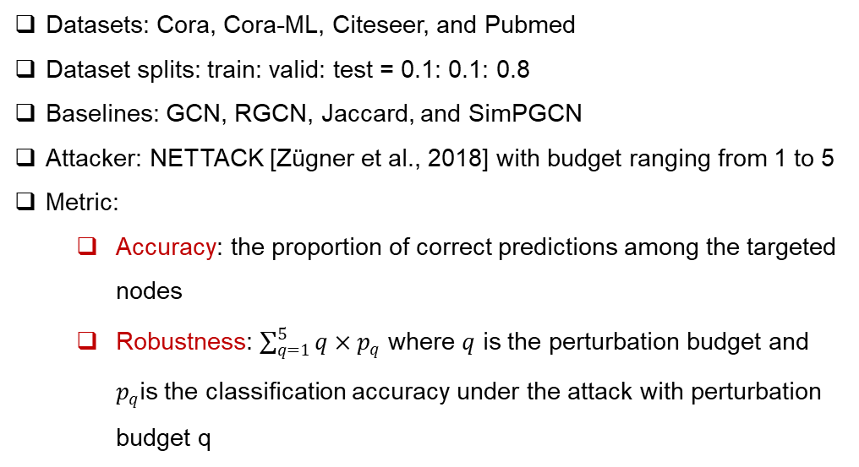
Experiments
Settings
Datasets: Cora, Cora-ML, Citeseer, and Pubmed
Dataset splits: train: valid: test = 0.1: 0.1: 0.8
Baselines: GCN, RGCN, Jaccard, and SimPGCN
Attacker: NETTACK [Zügner et al., 2018] with budget ranging from 1 to 5
Metric:
Accuracy: the proportion of correct predictions among the targeted nodes
Robustness: $\sum_{q=1}^{5}{q×p_{q}}$ where $q$ is the perturbation budget and $p_{q}$is the classification accuracy under the attack with perturbation budget q
Table: The statistics of datasets.
Approach
TMean: GCN with trimmed mean aggregation function
Median: GCN with median aggregation function

Slide 31
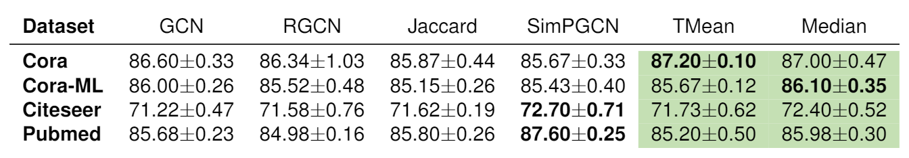
Results: Clean Accuracy
Table: The classification accuracy (%) on clean datasets
TMean and Median achieve comparable performance with baselines on clean graphs
Although trimmed mean and median discard extreme values during aggregation, their accuracy is not sacrificed

Slide 32

Results: Robustness against Attack
Table: The robustness of all models under direct and indirect attacks
Median aggregation outperforms all baselines under direct attack
TMean and Median effectively preserve structural information even against adversarial attacks
There is a close relationship between the robustness of the aggregation function and the whole model

Slide 33


Results: Robustness against Attack
GCN against Attack
Before
After
MedianGCN against Attack
Before
After

Slide 34




Results: Robustness against Attack
(a) direct attack
(b) indirect attack
Figure: Robustness against direct and indirect attack.
TMean and Median generally outperform baselines with increasing perturbations
The accuracy of GCN quickly drops but our methods still have high robustness
Employing a more robust aggregation function is crucial for defending both direct and indirect attacks

Slide 35
Outline
Background
Robustness Analysis
Experiments & Results
Conclusion & Future Work

Slide 36
Conclusion & Future Work
Conclusion
The aggregation function of GCNs has a large influence on its robustness
Trimmed mean and median aggregation function can improve the robustness GCNs
Our methods can significantly improve the robustness of GCNs against adversarial attacks without sacrificing the classification power
Future Work
Analyze the non-targeted attacks and poisoning attacks on GCNs
Develop models that are robust against both the targeted and non-targeted attacks
Scalable defense methods on large scale graph

Slide 37



Repository
Awesome Graph Adversarial Learning: paper list
Link: https://github.com/gitgiter/Graph-Adversarial-Learning

Slide 38


Repository
Awesome Graph Adversarial Learning: paper list
Link: https://github.com/gitgiter/Graph-Adversarial-Learning

Slide 39

Repository
GraphGallery: PyTorch based GNN model gallery
Link: https://github.com/EdisonLeeeee/GraphGallery

Slide 40
Repository
GraphGallery: PyTorch based GNN model gallery
Link: https://github.com/EdisonLeeeee/GraphGallery
Input Graph
Model Building
Training Pipeline
Built-in or
User-defined
Building Blocks
Early
Stopping
Model
Checkpoint
Logger
…
Model Gallery
…
Unified Interfaces for Training/Validation
Data Flow
Loss
Accuracy
Time
…
Graph Purification
Adversary
Detection
…
Unified Interfaces for Inference
Output Report
Inference Pipeline
Trained Model

Slide 41

Repository
GraphGallery: PyTorch based GNN model gallery
Link: https://github.com/EdisonLeeeee/GraphGallery

Slide 42

Repository
GraphGallery: PyTorch based GNN model gallery
Link: https://github.com/EdisonLeeeee/GraphGallery

Slide 43

Repository
GraphWar: Arms Race in Graph Adversarial Learning
Link: https://github.com/EdisonLeeeee/GraphWar

Slide 44

Repository
GraphWar: Arms Race in Graph Adversarial Learning
Link: https://github.com/EdisonLeeeee/GraphWar

Slide 45

Repository
GraphWar: Arms Race in Graph Adversarial Learning
Link: https://github.com/EdisonLeeeee/GraphWar

Slide 46

Thank you for watching
EdisonLeeeee/MedianGCN (github.com)
Contact me:
lijt55@mail2.sysu.edu.cn

Slide 47
Q & A
EdisonLeeeee/MedianGCN (github.com)
Contact me:
lijt55@mail2.sysu.edu.cn

